Slide 1
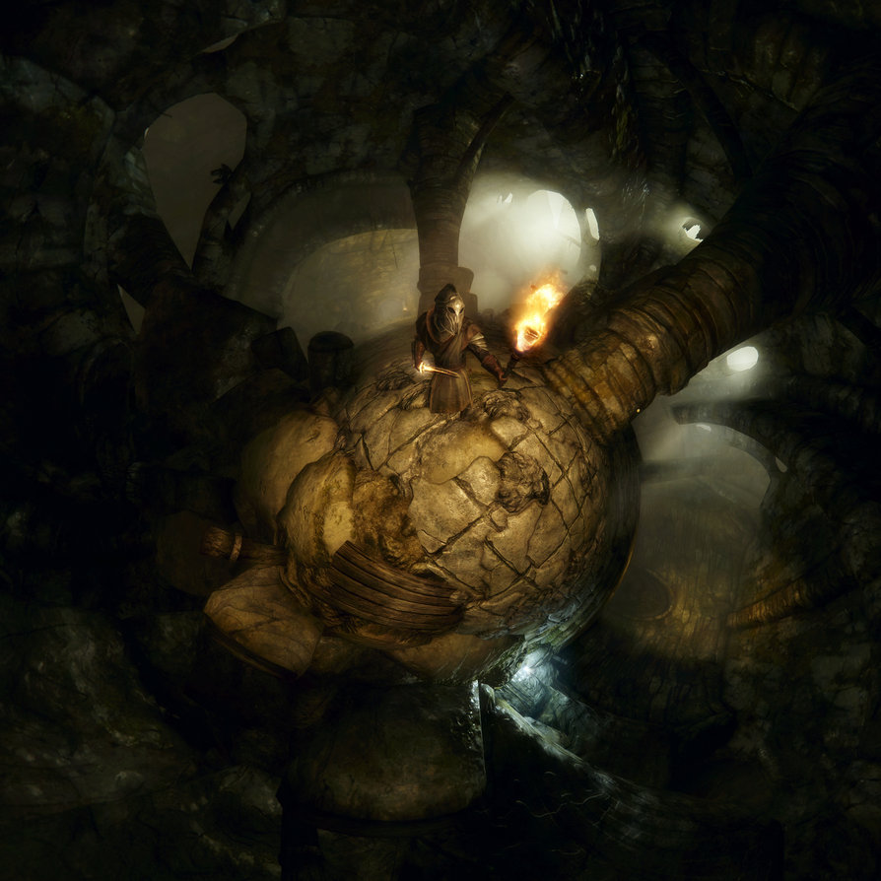
Emmet Boylan
Sandbox Warrior procedurally generated Roguelike

Slide 2
Presentation Outline
Introduction, Outline and Aims
Gameplay Demonstration
Main Presentation
Open Structure Including
  Questions and Answers
  Invitation to Play
  Code Addition Example

Slide 3
Project Aims
Produce a Completed Game
Evauate Java as a Game Development Language
Gain Experience with new Genre
Gain Experience with Procedural Generation and Open Ended Game Structure
Produce a solid basis for expansion into a project of far greater scope and potential release

Slide 4
Technology used
Language : - Java
Library : - Slick2D
IDE : - NetBeans
Supprting Software
  Photoshop
  FLICster

Slide 5
Design and Implementation
Design Plan
15 point plan detailed in report
Incremental approach
Codifies components needed to complete game to meet genre expectations

Slide 6
Design and Implementation
Project Structure
Project comprised of 40 classes in 8 packages
Inventory
ActorEffects
Actors
  states
GameStates
Simpleslickgame
Util
world

Slide 7
Design and Implementation
Game World
3 dimensional grid of Tiles
  Ease of Movement, Combat, Pathfinding
  Tiles contain graphics co-ordinates and blocking data
Tile based graphics
  Used for UI, game Tiles, Icons and Items
  Sub Images of Tileset Image
Also contains Lists of Game Entities and Items
  Contains utility methods

Slide 8
Design and Implementation
World Generation
Levels built at one time via Celular Automata
WorldBuilder class manages CA, determines regions and joins regions 3 Dimensionally
Factory Classes used to create game Items and Entities

Slide 9
Design and Implementation
Movement and Combat
Handled by Actor and AI classes
  Actor class handles game statistics and animation sate
  Decision making and utility methods handled by AI
Grid based movement and collisions
Combat simple and attritional

Slide 10
Design and Implementation
Vision, Line of Sight & Pathfinding
Handled by AI classes and util package
AI handles decision making and data gathering
  CanEnter checks if the tile is clear
  CanSeeLit raycasts within sight radius, passing through ground tiles, blocked by wall tiles
Util package includes points, collections of points and a Pathfinder, implementing the A * algorithm

Slide 11
Design and Implementation
Artificial Intelligence
Base AI class handles updates and line of sight calculations
Wandering Monster AI adds random movement and capacity to flip to Hunting Monster AI
Hunting Monster AI defaults to wander behaviour until target is in sight, then implements hunt

Slide 12
Design and Implementation
Actor Effects
Used to model ongoing effects to an entity
Each Actor contains a collection of Status Effects
  Effects updated on Actor update
  Reference to Actor, allows manipulation of Actor variables
  Effects can be permanent or temporary
  Used to model Hunger, Potion Effects etc

Slide 13
Design and Implementation
State Based Animation
Actors contain a collection of Animation States
  Idle
  Run
  Attack
  Death
Draw calls from the central game loop are passed to the current state
States have end conditions based on frameCount

Slide 14
Design and Implementation
Animations
Graphics come from fan made units for Civilisation 3 computer game
Converted to spritesheets via FLICster and Photoshop CS2
Lack of standardisation in Civ3 units requires a lot of offset data

Slide 15
Design and Implementation
Game Loop
Update screen offset reference
Increase frameCount
Every second frame
  If player is active
    Update player animation
  For each other Actor
    If active – update AI on frame 0, update animation
Get input

Slide 16
Status and Conclusion
Game is a complete implementation of a Roguelike
System Architecture allows for simple and rapid expansion
Successful test implementation of features needed for large Procedurally Generated world
  Need wilderness and home base areas
  Store level data by Seed
Possibility of platfrom conversion to Android

